Slide 1
Framing the Framework: An exploration of the ACRL Framework for Information Literacy for Higher Education within Nursing and Public Health
Xan Goodman
University of Nevada, Las Vegas
In Tune with the Future through Vision, Visibility and Partnership
Joint Meeting 2016, Stanford University
email: xan.goodman@unlv.edu/tel: 702-895-2233

Slide 2
Purpose
Explore the ACRL Framework for Information Literacy for Higher Education with the context of Public Health and Nursing

Slide 3
Authority is Constructed & Contextual
Notes:
Image source: https://www.flickr.com/photos/macwagen/131360868/in/photolist-cBg1y-6c4GFm-7T4nYt-aDZyQK-brxRtv-bEubNm-rgUE14-9jJ6se-819aj6-86qXZv-bBBXRX-C52LiY-9UcsAp-u9vjjh-zoFqD-mb6aJc-977Dks-dCQ4ym-dCJEuB-2aHREB-9ZWdWv-ei8C7h-nCVz5S-o4rNNH-i6FEXj-gah2jw-qocPJK-afXTnh-fT4dZe-bgnk4K-8ABEC6-nQRkVW-7T4nRc-an6VPS-dCQ4SA-fwiL8Y-8NJips-8MbXHi-njBHv9-df4Dik-dYciqX-6eHRzj-ecyK32-bb1fDi-nbNcq1-dCJEMD-oQCKD1-q6XLEk-dCQ4Cw-4pPs34

Slide 4
Information Creation as a Process
Notes:
Image: ALA photo from Edwidge Danticat talk

Slide 5
Information has value
Notes:
Image source:https://www.flickr.com/photos/jakerust/16205025164/in/photolist-qFYZpA-f9THop-5aWWFa-4LXY2M-fmpfDQ-7wMLPp-8S4XnF-iPJPd9-cYiF8W-8EqL2E-zyE9st-z6fnEY-7jTmr5-fmphAN-8UkC4u-oCLuwf-iPGQ8R-96SdfA-68wJ8d-7VHvh8-e8Qpr7-4Ekx8d-iPLzh1-ekx9R9-eouxKn-73APuw-7rPiMM-baPcze-hbiEoq-fma5Up-eHzRKs-61m23G-4N5j7o-9aZXdT-CQU9c-7rPjDx-o2E6H-fma83a-eHtJZ8-eHtEYr-du77no-7KYYbt-eHzTA5-o4WmL4-fma8XZ-o4dGo1-5KsJSs-fmpmn1-eXdQjw-hn5Bp1

Slide 6
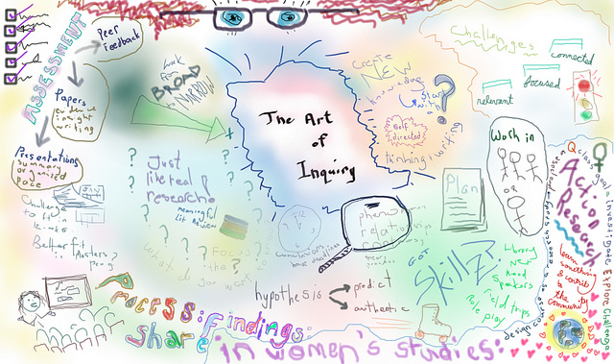
Research as Inquiry
Notes:
Image source:https://www.flickr.com/photos/cnast/5524124901/in/photolist-9q9zSM-qHQTLK-g1ofiw-7zfT8C-iPHMoE-gWE2Wt-jpSa3o-jpQo32-jpNKWZ-9eZQRE-gtbkUk-g1o3cL-g1osqe-g1nYv7-g1o4bR-g1ob25-g1okfT-g1oiJr-g1o77m-g1nPXL-g1nNaC-g1nK1c-g1nMwL-g1nvRq-6soa2A-g1nVV6-g1nsLN-g1nr1J-g1nEz9-g1nnhS-g1nzds-g1nfNE-g1nijn-9c2ioW-jpQHZC-gWEdc8-jpQmHt-jpQFf9-bDscRk-8Qjgbz-gWCZLw-gWE6AT-byMRVh-7zf7mN-heVTk-edVyhz-bBTQDT-9c2wzd-7KN9au-w4pbnf

Slide 7
Scholarship is a Conversation

Slide 8
Searching is Strategic
Notes:
Image source:https://www.flickr.com/photos/dullhunk/3389581452/in/photolist-6awutw-m9mdpr-73Gqjb-92t8FA-fnpaj6-5NByM-9qPsEz-c3vzMS-2TvQM-6ACxYZ-ak9r9P-6XDRut-9XK9j3-ggHwRT-9pxAme-8jemiE-8xvN79-poXdjM-9qSspN-aPSYTz-aoDAFg-cNiRCE-vvgXpq-5UsmSB-9qSsqf-vLRdCE-bDFtzN-tmYRuc-765teS-qeBM6u-5DPeQ8-CwGmLn-dHT4pr-6YwPJS-cNiRUY-AJkvuS-9LxXM2-9Bzjqm-edUmxA-7FNAes-LiTYT-qkwHZM-pwaNN3-pybka9-pgGSYZ-pxVLWZ-pgGXs9-pgGU8y-pwaoBY-7vGv9A

Slide 9
Public Health

Slide 10
Rubric
 | Frame | Authority AIC&C | Info Creation ICAAP | Info Value IHV | Research Inquiry RAS | Scholarship Convo SAC | Search SASE
Public Health Outcomes
Locate, use, evaluate and synthesize public health info |  | X | X | X | X |  | X
Use of mass media & electronic technology |  | X | X | X |  | X
Underlying science of human health & disease, health promotion |  | X | X | X | X | X
Evidence-based approaches to public health |  |  |  |  |  | X
Students’ adherence with APA (title page, in-text citation and reference page)
Quality of sources (relevant journal/websites, standards, and external sources).
Notes:
Locate information: Search as strategic exploration. How to have Public Health students learn how to use the tools of Public Health to find and locate information but also to think of their search process as strategic

Slide 11
Nursing

Slide 12
 | Frame | Authority AIC&C | Info Creation ICAAP | Info Value IHV | Research Inquiry RAS | Scholarship Convo SAC | Search SASE
Nursing Essentials
Knowledge and skills in leadership, quality improvement, and patient safety. (Essential 2) – Capstone Papers |  | X | X | X | X |  | X
Professional nursing practice is grounded in the translation of current evidence into one’s practice. (Essential 3) |  | X | X | X | X | X | X
Knowledge and skills in information management and patient care technology are critical in the delivery of quality patient care. (Essential 4) |  | X |  | X | X | X
The baccalaureate graduate understands and respects the variations of care, the increased complexity, and the increased use of healthcare resources inherent in caring for patients. (Essential 9) |  |  |  | X |  | X

Slide 13
Thank You
Xan Goodman, xan.goodman@unlv.edu
University of Nevada, Las Vegas

